Slide 1
Design Patterns Concepts
Notes:
0.5 min

Slide 2
How many design patterns are there?
“Design Patterns: Elements of Reusable Object-Oriented Software” (“Gang of 4”) described 23 patterns
More can be created, but these are well-recognized
We create / discover custom patterns all the time
May bear similarities to existing patterns
May be insufficiently different to be considered something new
Notes:
1.5 min

Slide 3
Patterns from a Birds-Eye View
Generally, we consider three (3) types of patterns.
Creational
Factory
Builder
Prototype
Singleton
Structural
Adapter
Bridge
Composite
Decorator
Façade
Flyweight
Proxy
Behavioral
Chain of Responsibility
Command
Interpreter
Iterator
Mediator
Memento
Observer
State
Strategy
Template
Visitor
No need to learn them all, and some might be used much more frequently
Notes:
4 min

Slide 4
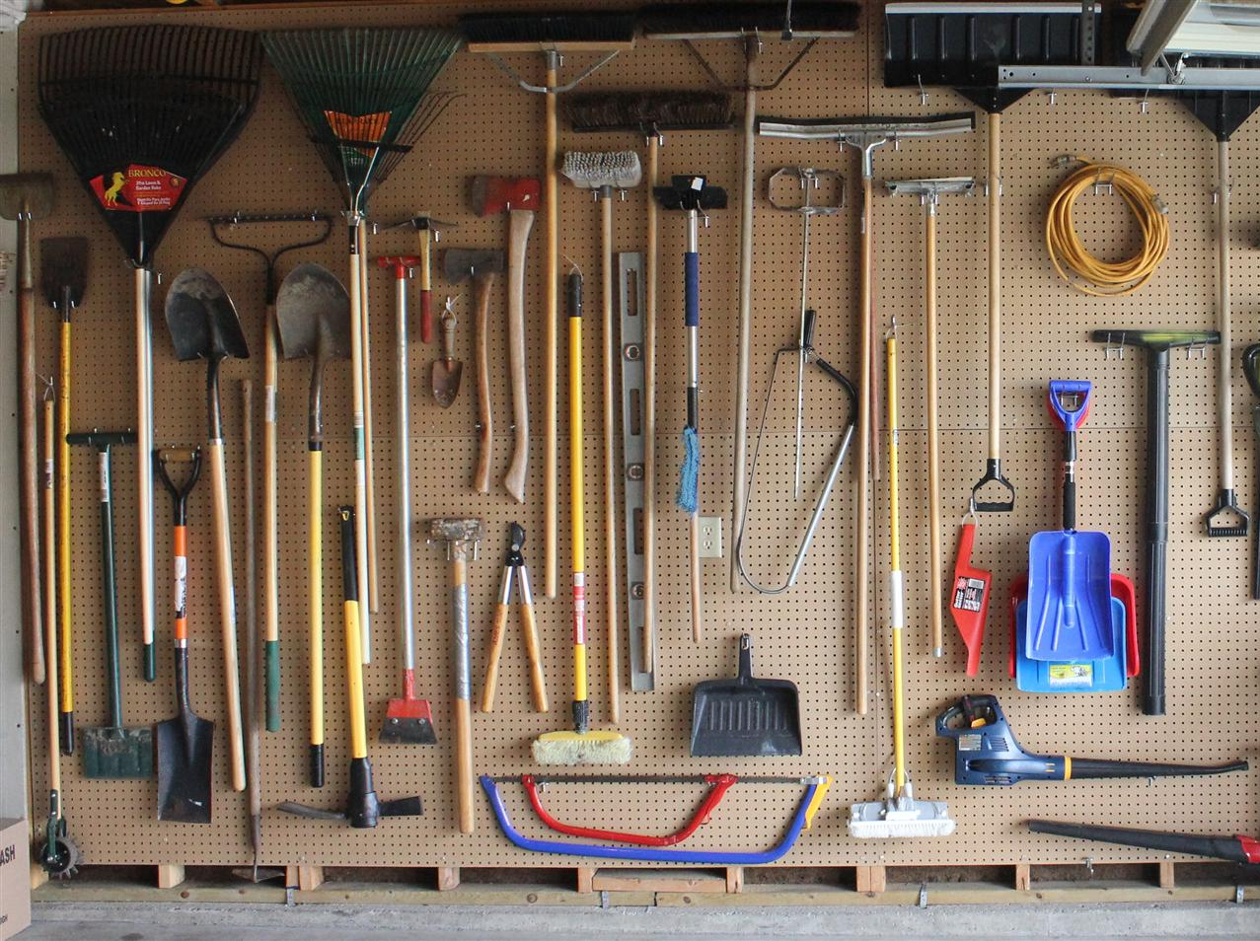
Design Patterns – How & Why
Design Patterns provide a formalized solution to a set of problems.
Abstractions help us think about and compare solutions
Array? Vector? Linked List? Deque?...
Are they interchangeable? What’s the tradeoff?
If it’s just “magic”, it’s hard to analyze.
So I should use all of them for every project, right?! (no.)
Choose the right tool for the job
A shovel is great for digging or filling holes
Not so good at pounding nails, removing screws, raking leaves, etc.
Hopefully none of those are still magic to you… #sadinstructor
Notes:
1.5 min

Slide 5
What is the “Right Tool for the Job”?
3D Modeler
Could be a terrible choice to use here
This pattern…
How do we know? Learn it, think about it, try it out, screw it up, try again, etc…
Text Editor
Game
Menu UI
Camera
We almost always need to tailor patterns to our needs. That’s OK! Formalization might not perfectly fit our use case as-is, so we rework them (with care)
Notes:
1.5 min

Slide 6
Anti-Patterns
The opposite of design patterns
If design patterns are helpful, then anti-patterns are:
Things you have probably done or will do some day
But you should probably avoid…
They may be things that you (or your team) do unintentionally
Originally coined to describe bad practices in software, might also be applied to problem solving in general
May often be used to describe issues not specific to code
Notes:
1 min

Slide 7
Anti-Pattern: Bicycle Shed
Want to build something big and impressive, like a football stadium?
What should be focus of design or architectural work? What should have the most effort put into it?
The parking structures? Load-bearing supports for all of the seats? What about a dome? Sound system?
Hmm, those sound like hard problems to solve…
What about the bicycle shed used by employees?
Easy to figure out, let’s focus on that!
Build the most impressive bike shed ever!
The same can be done with code. Write code to solve easy stuff, and focus on that…
…while avoid the more difficult aspects of a project
Some design patterns may drawbacks to them, and may be considered anti-patterns if not implemented carefully
Notes:
2 min

Slide 8
Criticisms of Design Patterns
There is some criticism of design patterns as unnecessary.
Argue that they are ways to paper over language-specific deficiencies (e.g., vs LISP)
By relation, some programming paradigms (up next!) have them “baked in”
Can be easily abused / overused (i.e., they can become anti-patterns)
As with many ideas in artistic craft – few rules are absolute. Rules are for breaking! ☺
(But not my rules. Follow those. Also, don’t ever overload parens for non-functors.)
(#bracesonnextlineftw, #spaces4ever)
Notes:
0.5 min

Slide 9
Recap
Design patterns are known solutions to common problems
We can implement these to (help) solve problems
Patterns are conceptual; exact implementations vary
Not all patterns are applicable to all programs
Patterns can help us build systems more effectively
Avoiding anti-patterns can help us doge common pitfalls
Notes:
0.5 min
Total: 14 min

